Slide 1
Getting started with Arduino
My Journey so far with Arduino, by Pat McMahon -V6 -8/12/2022

Slide 2
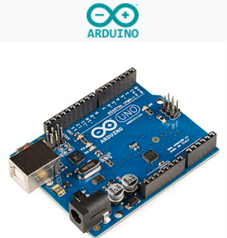
What is a Microcontroller.
What is an Arduino UNO.

Slide 3
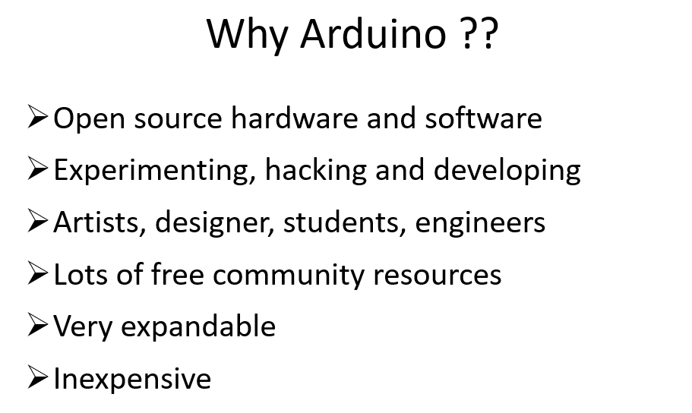
When, what and why.
> Free Arduino IDE ( Integrated Development Environment) uses a form of c/c++ language for Coding Sketches while the Processing’s underlying language is Java.

Slide 4
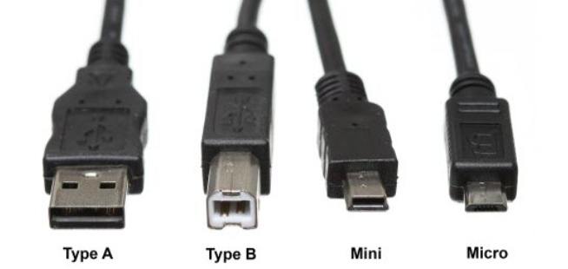
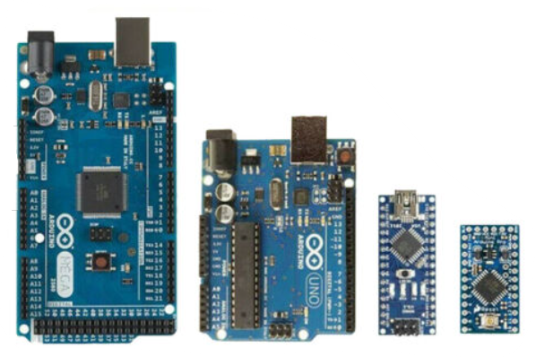
Some of the popular Arduino Boards
External DC Power Jack
USB A-B Cable
USB A-Micro B Cable
No external Power Jack
Has to be put onto a Bread Board to be powered and programmed
Mega
16 Analog-54 i/o Digital
70 Pins
Uno
6 Analog-14 i/o Digital
20 Pins
Nano
8 Analog-14 i/o Digital
22 Pins
Mini Pro
6 Analog-14 i/o Digital
20 Pins

Slide 5
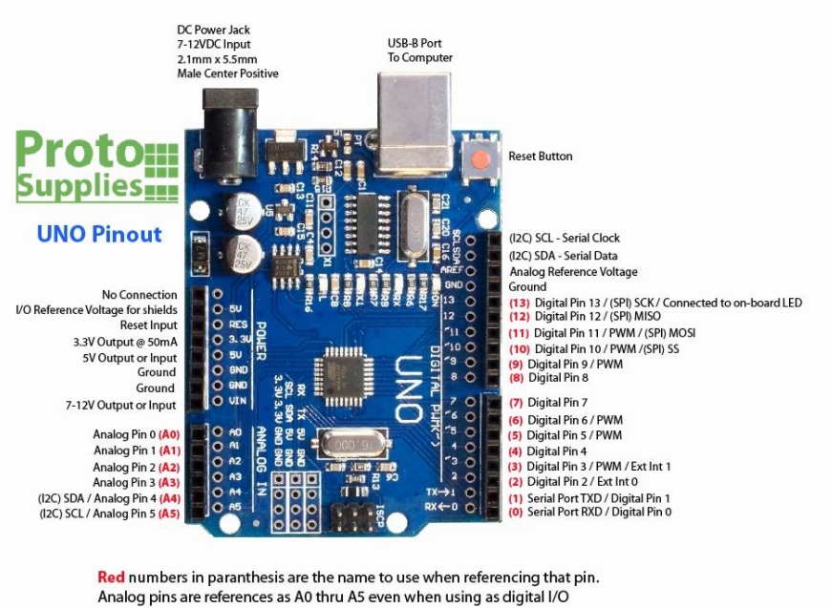
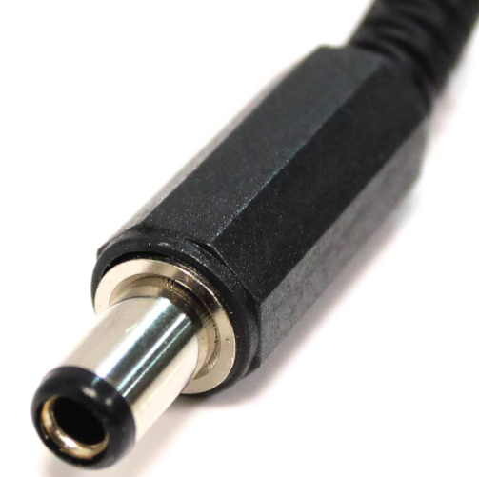
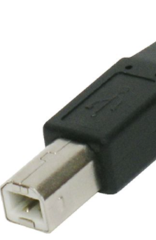

Slide 6
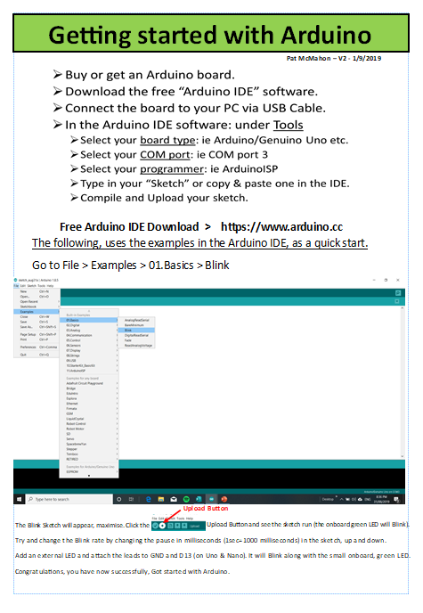

Slide 7
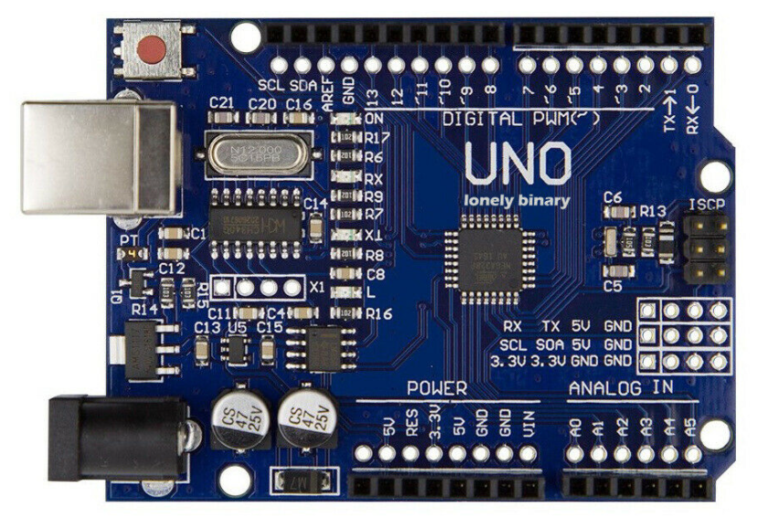
Arduino Uno R3 Compatible Development Board
14 Digital i/o
6 Analog

Slide 8
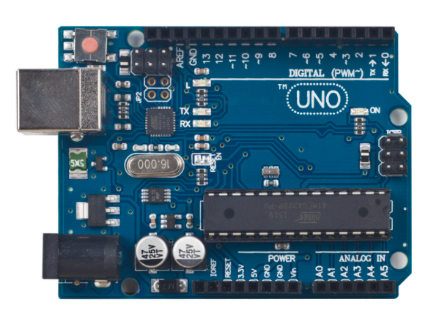
Arduino Uno R3 Compatible Development Boards
Old ATMEGA16U2
Updated ATMEGA328P

Slide 9
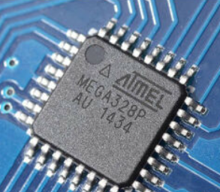
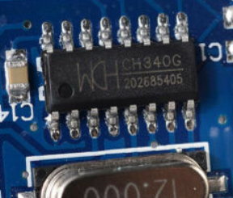
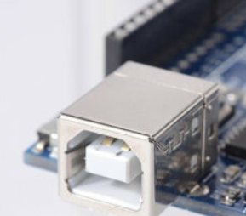
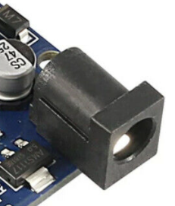
Arduino Uno R3 Compatible Development Board
- 6 Analog Pins
- 14 Digital pins (6 ~ pwm)
ATMEL ATMEGA 328p
Microcontroller Chip
CH340G
USB Driver
USB Type B
USB Bus Adaptor
5.5 mm Diameter
DC 7 to 12 V
External Power Jack

Slide 10
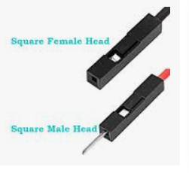
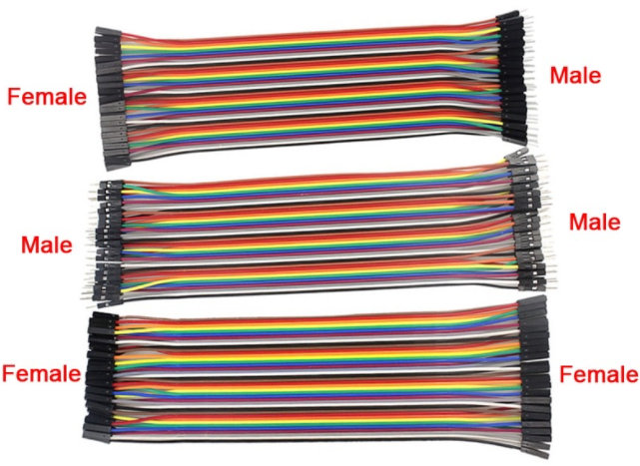
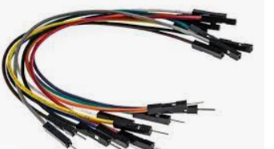
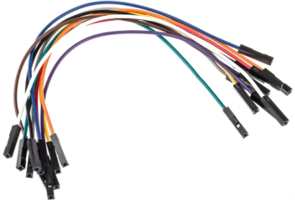
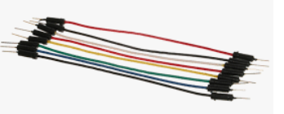
Dupont Jumper Wire Connectors
They come in 3 Types, various Colours and Lengths from 10 cm to 30 cm.
They are made to fit into the 0.1 (1/10th) inch pitch spacings on Arduino boards Headers.
3 Types
Align all openings when connecting
Male to Male
M-M
Female to Female
F-F
Male to Female
M-F

Slide 11
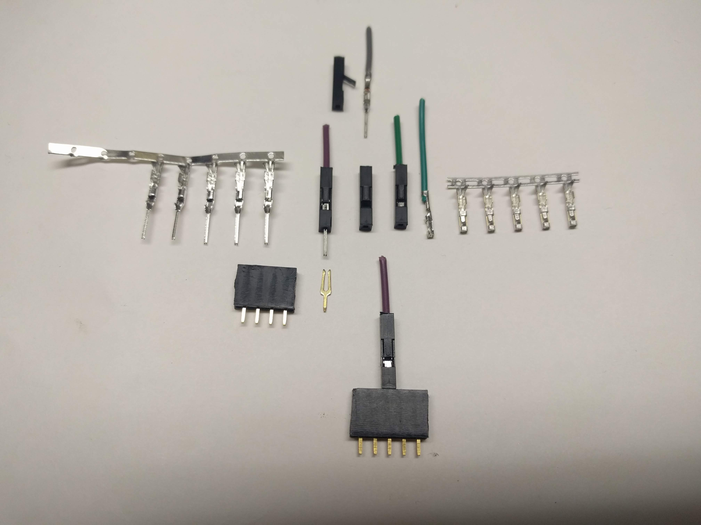
Inside a Dupont Wire Connector
Pat McMahon V1 20/5/2023
Dupont
Wires
“Locking Clip”, lift to release wire.
Pressed Male Strip
Pressed Female Strip
Pat’s Modified Arduino Uno with extra Positive & Negative Headers and colour stripes for easier identification.
“Flat Knife Like”
Correct insertion in Header, “Shiny metal/locking clip” facing Inwards or Outwards
to Uno, not sideways.
Header Pins on Uno has a “Tuning Fork” looking connection inside.

Slide 12
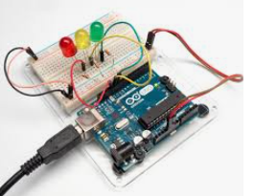
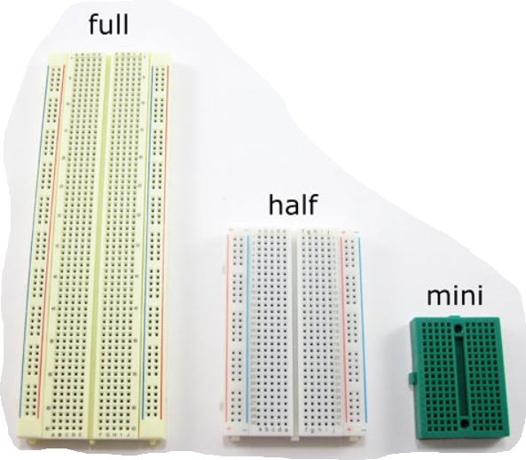
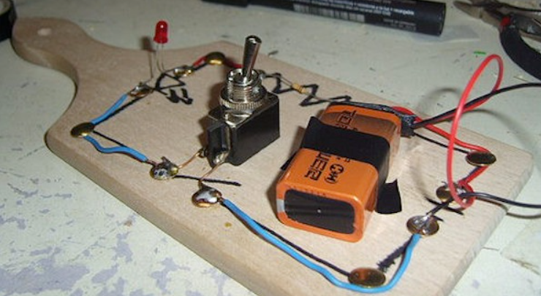
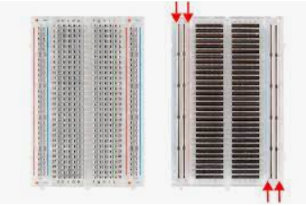
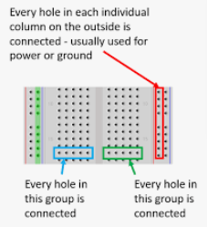
Bread Boards
A breadboard is used to build and test circuits quickly before finalizing any circuit design. The breadboard has many holes into which circuit components like ICs and resistors can be inserted. A Bread Board is Solderless.

Slide 13
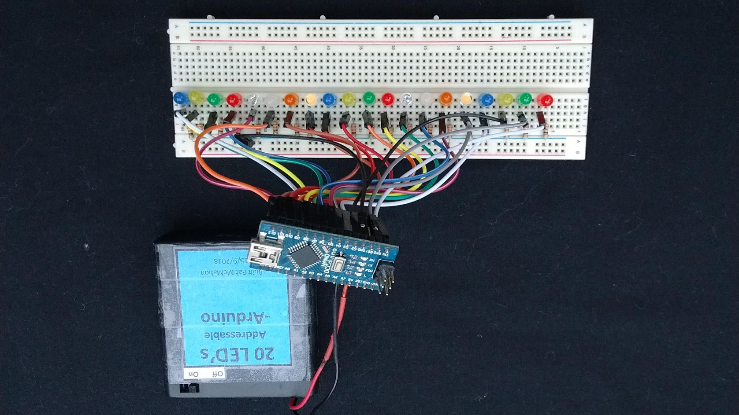
Bread Boards, Dupont Jumper Wires & Shields
I have found that Bread Boards and Dupont Jumper Wires are great for my static models and for Prototyping.
On moving models such as Robots, I have found that the Jumper wires can come loose and even break with lots of movement.
I have found that Soldering the wires and components onto a shield that fits on top of the Uno, is a far neater and more durable method.
Compact & Neat
Bluetooth,
Infrared, LED,
Motor Driver,
Buzzer,
Motor & Battery
Connections
UNO Shield
Components & Wires, Soldered underneath the Shield
Blank UNO Shield

Slide 14
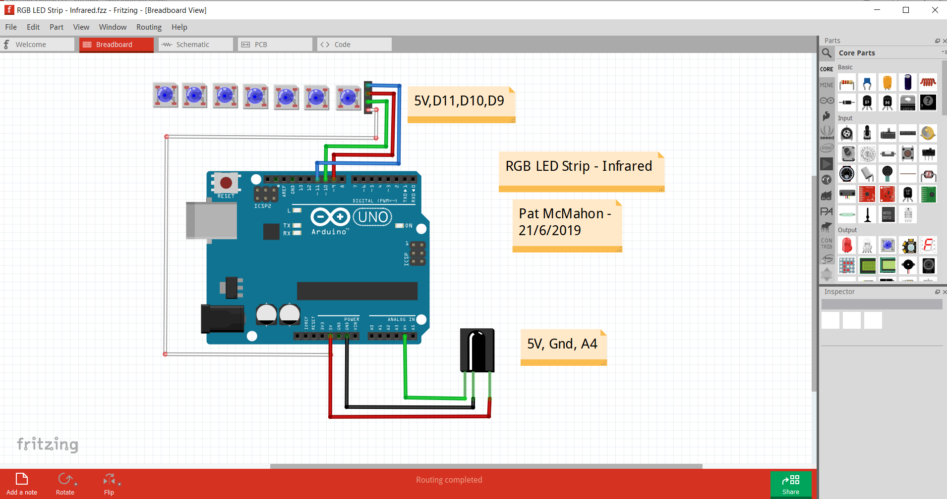
Fritzing
Fritzing is anElectronic Design Automationfor designers, artists and just anyone who has interest in physical computing and prototyping. Fritzing provides free and easy tools for documenting and sharing physical computing projects, producing layouts for Printed Circuit Boards (PCB) and teaching electronics.
It allows you to swap from the Diagrams below to Schematic to PCB to Code. It has a variety of microcontroller types and components. People use Fritzing to explain their circuit connections.

Slide 15
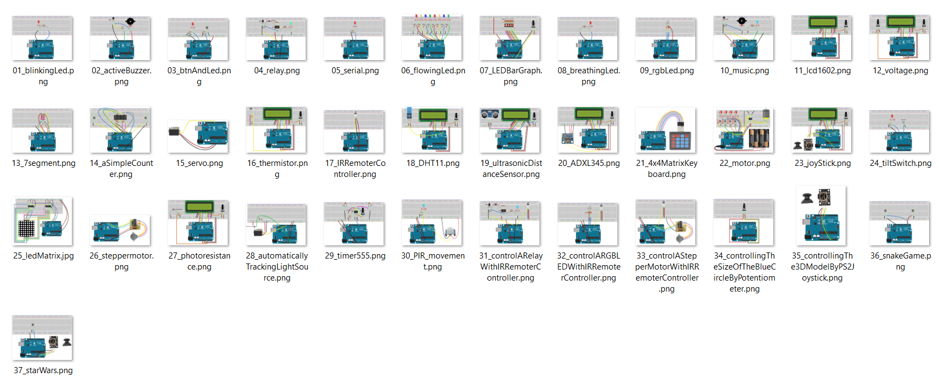
Fritzing
Some suppliers selling Arduino UNO kits use Fritzing to visually explain the physical connections for each project , as below.

Slide 16
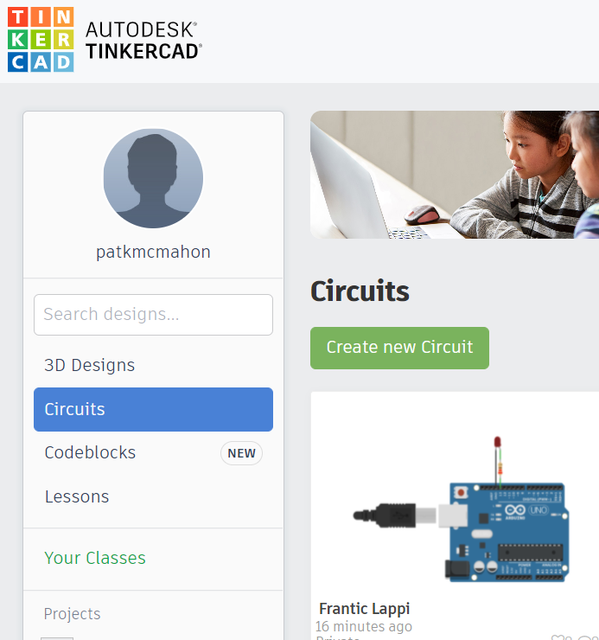
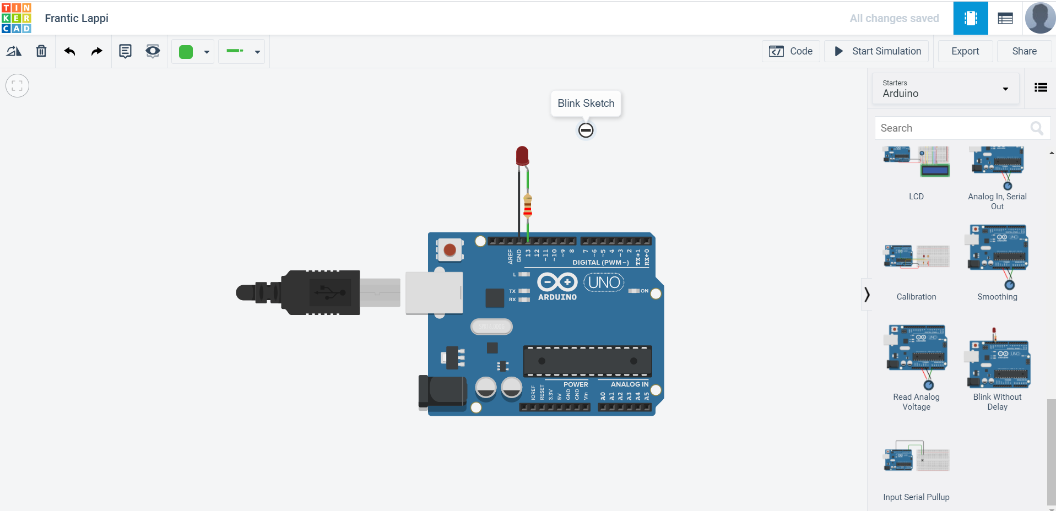
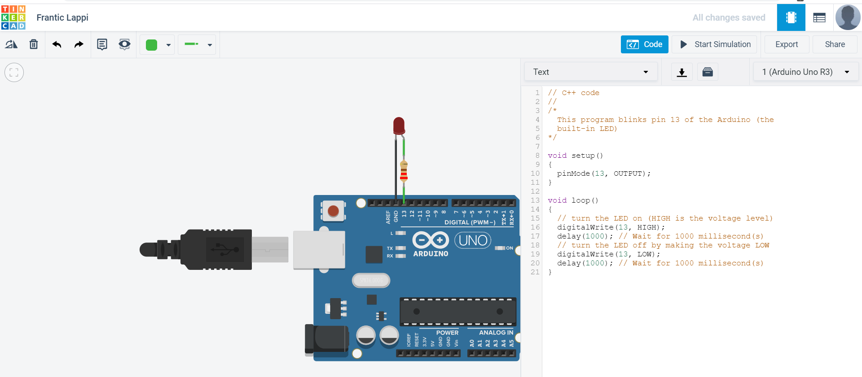
During recent Lockdowns some of my colleagues used the free TINKERCAD Circuit program to teach Arduino circuits and Coding remotely.
3 – Gallery- Lots of examples
1 – Log in to TINKERCAD
2 – Select Circuits
4 – Select Create new Circuits, ,
create your own (100 components)
5 - TINKERCAD has under Arduino UNO R3, 23 examples that you can select and pull across, simulate & see Code.
Recent shared examples
7 - You can start and stop the Simulation of the Sketch to see components flashing and hear sounds.
6 -You can show the Code in Text or Blocks.
8- Highlight the Text, Copy and Paste into the Arduino IDE, Upload & Run.

Slide 17
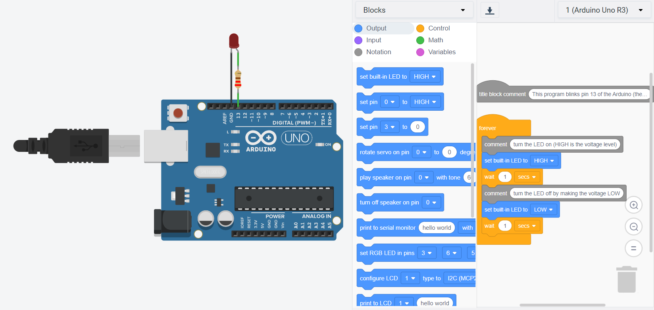
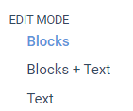
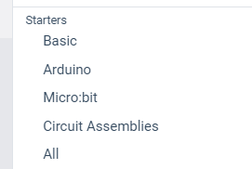
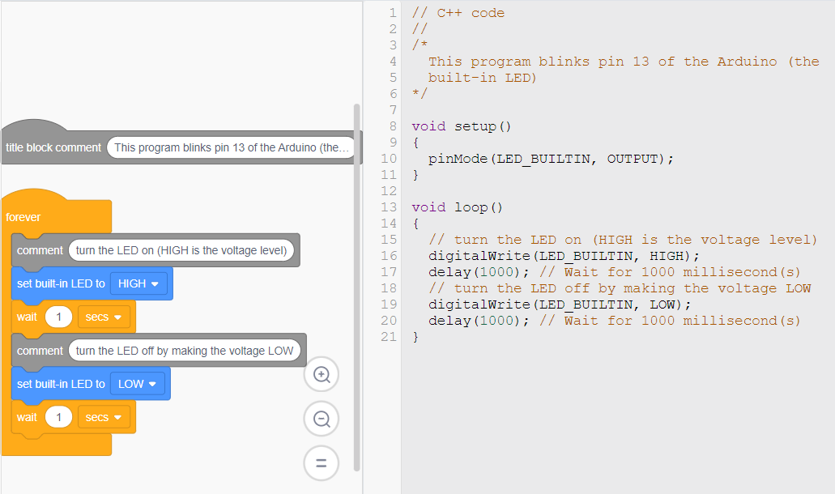
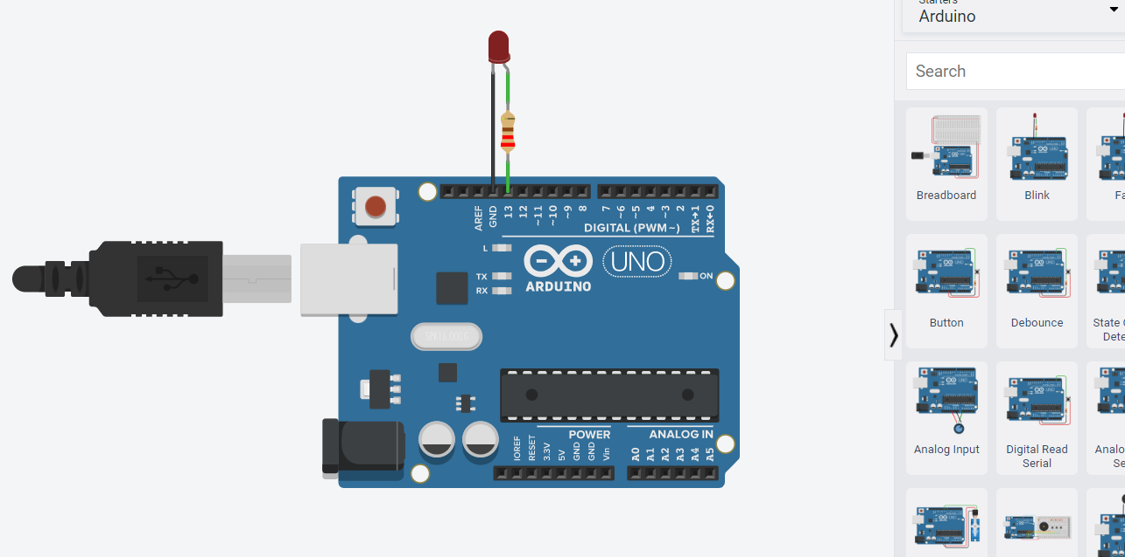
Using TINKERCAD Block Coding to Code your Arduino
For Arduino beginners, this will help you without the knowledge of the C++ programming language, write a program, that is, assemble a program from blocks and upload it to the Arduino board. Instead of writing code, worrying about syntax, and (mis)placing semicolons, curly brackets etc, this allows you tovisually programa snapped-together list of code blocks.
Pat McMahon V1
–14/8/2022.
Design Brief - We will use Tinkercad Block Coding for the Blink Sketch, convert it to text, copy it and paste it into the Arduino IDE and Upload and run the Blink Sketch on your Arduino Board.
1—Join or Log into Tinkercad.
2— Go to Circuits.
3—Create a New Circuit.
4— Go to Components Basic
5—Go to Starters >Arduino.
6—Pull across the desired Uno Picture you choose ie Blink
7— Select Code Blocks appear for Blink Sketch.
Try to see the simulation Run, change the waits and test.
8—Go to Blocks
Select Blocks & Text.
9— Highlight and Copy all the Text.
10—Paste the Text into the Arduino IDE, Rename it, then Upload to run the sketch on your Arduino.

Slide 18
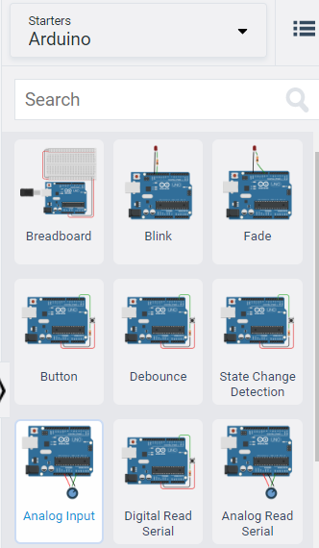
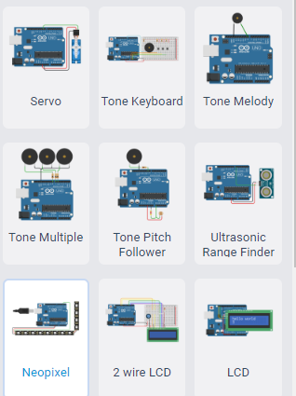
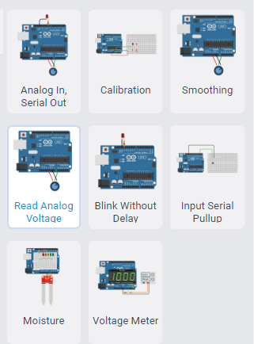
Tinkercad Arduino Starters with Block Codes
Pat McMahon V2 15/8/2022.
Using TINKERCAD > Starters Arduino, the pictures with Red Blocks have both Block Code and Text Code. ie 18 of the 26 examples have both Block & Text Code, 8 have Text Code only. Highlight & Copy the Text Code, Paste it into Arduino IDE, Rename it, Upload and Run it on you Arduino Board with your components connected.

Slide 19
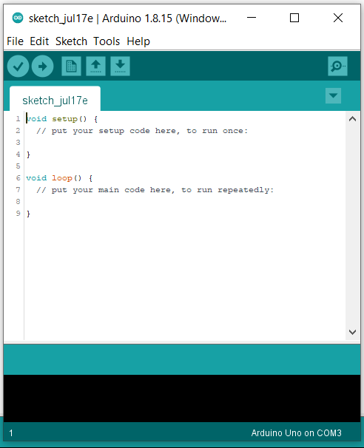
In the Arduino IDE when you open a File>New Sketch, it comes up as in the diagram below, with the “sketch_jul17e” name until you save with your own sketch name. Once you enter any code it will come up with “sketch_jul17e ” until you save your work.
New Sketch
Open Sketch
Save Sketch
Uploads to the Board
Compiles and then transmits over the USB to your Board.
Shows Serial Monitor
Verify (Compiles)
Before your program “Code” can be sent to the board, it converts and checks for any errors in instructions, that the board can understand.
Sketch always has a setup and a loop.
void means it doesn’t return any values.
Arduino IDE
(Integrated Development Environment)
Sketch Editor
Text Console
Will display any Status & Syntax Error messages in the Orange pop up section.
Shows the type of Arduino connected and the USB port it is connected to, ie Uno com port 3
Shows the line number the cursor is on.

Slide 20
Arduino Sketch— Open the Arduino IDE go to File > Examples > 01.Basics > Blink
The following explains the Blink Sketch example.
Pat McMahon 14/6/2020
/* This Sketch is a description of how to Code, an Arduino, for the Blink LED example.
*It turns the onboard LED on and off every 500 milliseconds (1/2 second) */
// Written by Pat McMahon—14/6/2020
const int KPinLED=13: // Declares constant on pin 13
Write comments, notes
Connections etc.
Import needed libraries Declare Constants and Pin Numbers
Declare objects Declare Variables
GLOBAL SCOPE
void setup ()
{
Pinmode (KPinLed, OUTPUT); // initializes digital pin KPinLed as an output.
}
SETUP SCOPE
setup () is called once only when you power the board or when you press reset.
void loop ()
{
digitalWrite (KPinLed, HIGH); // turn the LED on (HIGH is the voltage level)
delay (500); // wait for 500 milliseconds.
digitalWrite (KPinLed, LOW); // turn the LED off by making the voltage LOW
delay (500); // wait for 500 milliseconds.
}
LOOP SCOPE
loop() is called over and over again as long as the Arduino has power.

Slide 21
Some Explanations and Hints to help reduce ERRORS in your Sketch
Note– Below are some explanations and hints I have found to help reduce ERRORS In your Sketch.
The Arduino IDE (Integrated Development Environment) allows you to create, open and change sketches.
Each Sketch can have a Global Scope, but must have a Setup and Loop Scope.
Void means that the function doesn’t return any values
The programming language is case sensitive. In other words , myVar is different than MyVar
Whitespace (spaces, tabs, blank lines are all collapsed to the equivalent of a single space. It is for the human reader only.
Blocks of code are encapsulated with curly braces ’ {’and ’}’ Highlight one and it indicates it’s matching mate.
Check in setup and loop that you have equal numbers of open curly { braces and closed curly } braces.
Every open parenthesis ’(’must have a matching close parenthesis’)’
There are no commas in numbers. So you must say 1000 and NOT 1,000.
Each program statement needs to end with a semicolon’;’. In general, this means that each line of your program will have a semicolon. Exceptions are:
– Semicolons (like everything) are ignored in comments – Semicolons are not used after the end curly brace. ’}’
Int Have no numbers in them ie ( 3LED) and no spaces ie (SET LED) in between words.
/* opens lines of comments, */ closes lines of comments.
// For single line comments.
Avrdude error—check under tools, ensure correct board type.
INPUT, OUTPUT, HIGH, LOW are all in capital letters, not lower case.
.Ino arduinosketch.h is a header file, .cpp is a source file, implements what the library can do.
This symbol at the end of your sketch name indicates the current sketch is not saved.
The Relationship of pinMode(), digitalWrite() and digitalRead()
If pinMode configures a digital pin to behave as an input, you should use the digitalRead() function. If the pin is configured as an output, then you should use digitalWrite().

Slide 22
Some ERRORS you may encounter
Note– Below are just some of the ERRORS I have encounted in my Coding (my attempts to explain are in red)
Not declared in this scope.
Expected initializer before.
Expected constructor, destructor or type conversion before “{“token.
A variable and a function cannot have the same name.
“ “ Does not name a type.
Expected unqualified ID before ‘if’
Int no numbers, no spaces.
Expected declaration before “}” token. Check that you have an equal number of open { & closed } curly braces.
Unsigned integer.
You cannot have an array and function with the same name
Exit status “ “ was not declared in this scope
Int avrdude Check the Board Type
Const int buzzer=9 buzzer must be in lower case.
DigitalWrite (in1, HIGH): HIGH must be in capitals.
PinMode (in1, OUTPUT): OUTPUT must be in capitals.
INPUT, OUTPUT, HIGH, LOW are all in capital letters, not lower case.
Click on the { opening curly brace and it will highlight its } closing curly brace.
This symbol at the end of your sketch name indicates the current sketch is not saved.

Slide 23
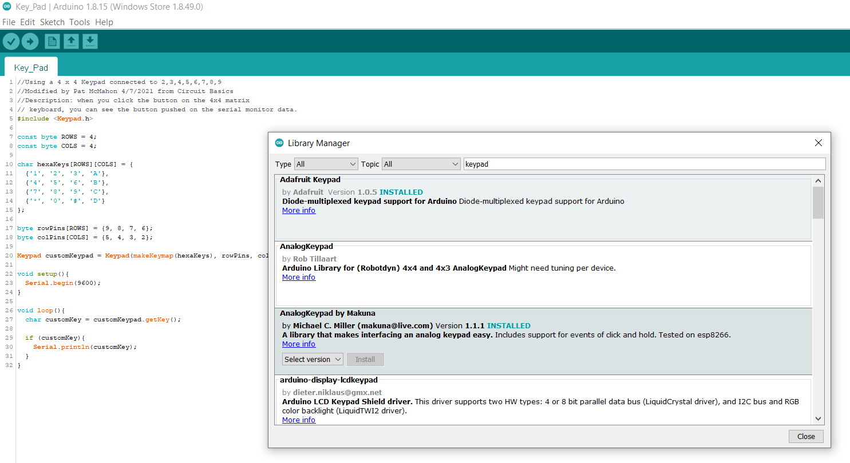
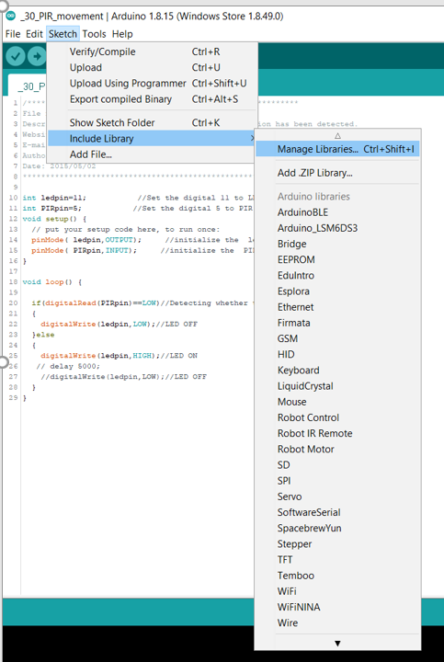
Libraries
Some sketches from the internet require the inclusion of specific libraries to be added to enable them to run. These libraries do lots of the complex Coding to make your sketch shorter and easier to run. The Arduino environment can be extended through the use of libraries, just like most programming platforms. Libraries provide extra functionality (e.g. the ability to control an LED matrix, or read an encoder, etc.). for use in sketches, e.g. working with hardware or manipulating data. To use a library in a sketch, select it from Sketch > Include Library> Manage Libraries.
1 - Go to Sketch > Include Library> Manage Libraries
2 – This Library Manager will pop up
3 – Type in Keypad
2nd way is to add a Zip Library
This Keypad sketch requires the Keypad Library
Built in Libraries pre installed in the IDE
4 – Select the keypad of your choice, click Install
5 – Keypad will now be added to the built in Libraries
What is a Library and how do they work?
A library is a collection of resources designed to simplify a process or task. These resources can include (but aren't limited to): subroutines, functions, classes, values or type specifications. A library typically consists of:
A Header File (.h) - This contains the library's definitions
Source Code (.cpp) - This contains the library's code
A Keyword file (.txt) - This contains the keywords used in the library
A Readme file (.txt) - This contains other information about the library (Revision Number, TODO's, etc.)
Examples (.ino) - These are to show a user how to operate the library
A second way to add a Library is to
Go to Sketch > Include Library> Add Zip Library
Search online, Arduino IDE installing Libraries for further explanations and details.

Slide 25
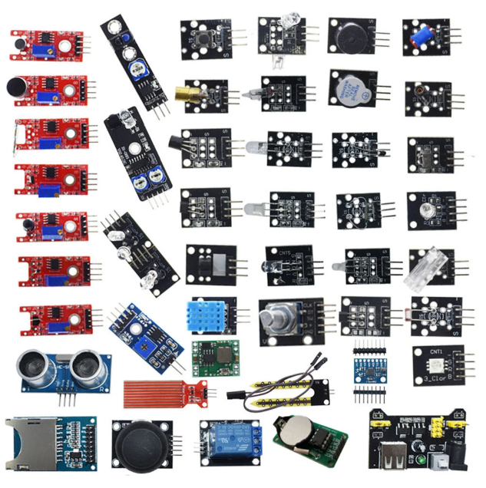
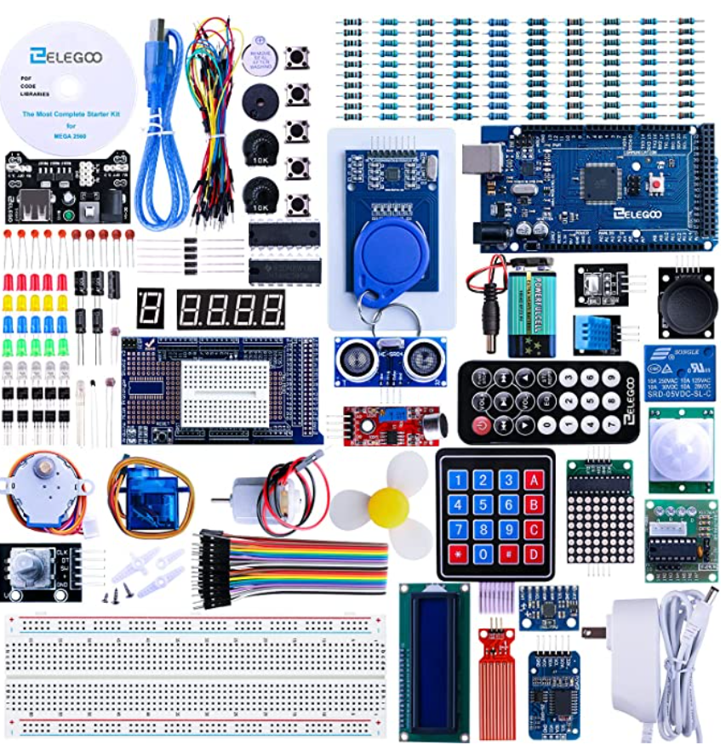
Sensor Kits
There are a whole variety of different Sensor Kits available from local suppliers and online, to suit your requirements and needs. (ie 37 in 1, 45 in 1 etc)

Slide 26
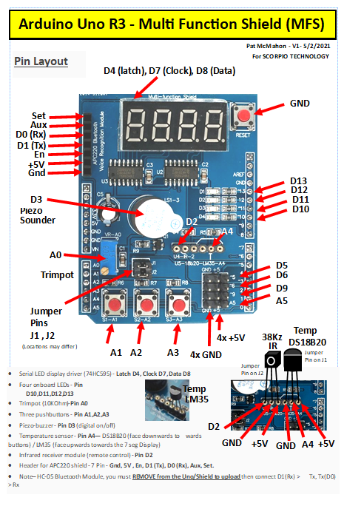
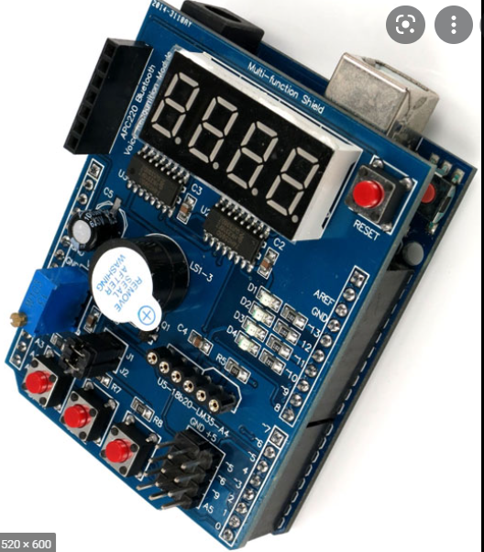
Shields
Shields (sometimes called Hats) are a cheap, easier and neater way of building projects. They simply fit on top of the UNO.

Slide 27
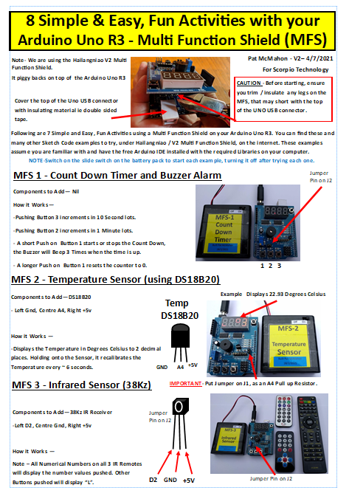

Slide 28
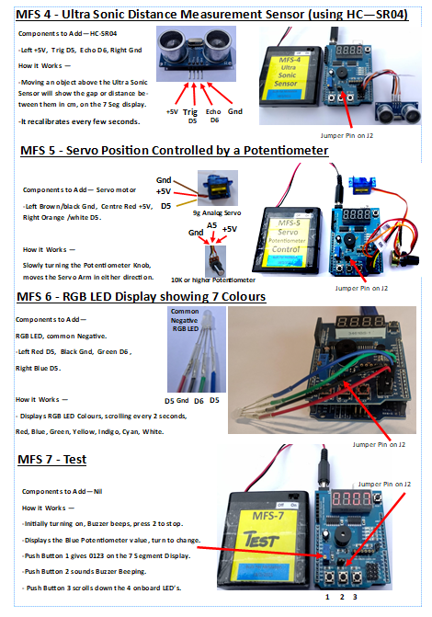

Slide 29
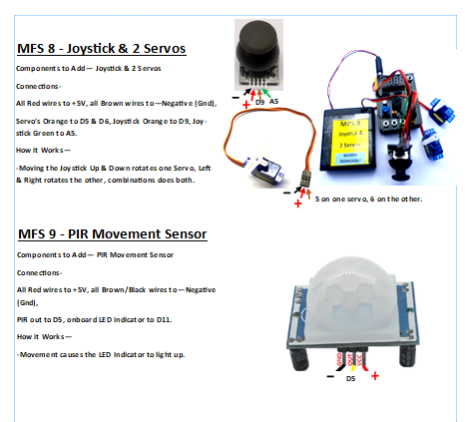

Slide 30
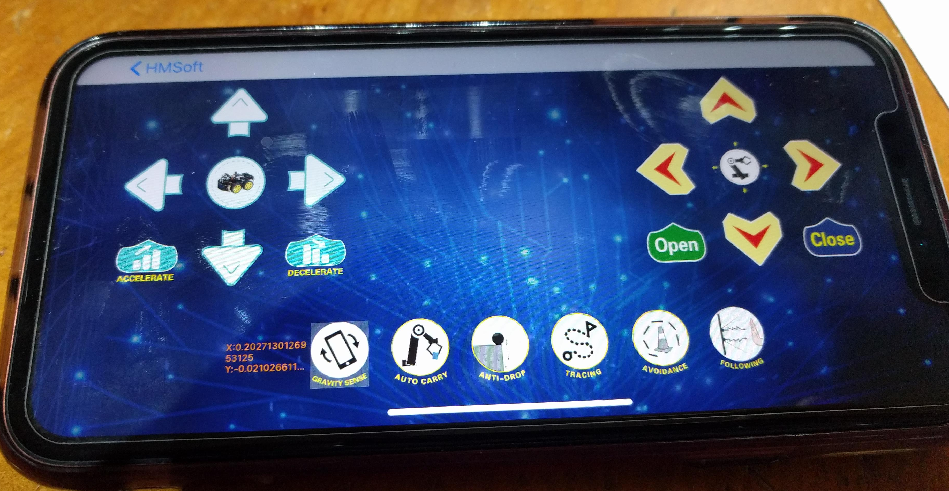
How to run Bluetooth on your Smart Phones
CAUTION—From previous experience, please ensure the Bluetooth Robot is on the ground before continuing.
Pat McMahon V1 16/8/2022
Android Phone uses (HC-05) Bluetooth Module
i Phone uses (BT-05/HM-10) Bluetooth Module
1— Go to the Play Store and install the Arduino Bluetooth RC Controller App, on your Android Phone.
1— Go to the Apple store and install the Keyes BT car App, on your iphone.
Keyes BT car
Arduino Bluetooth RC Controller
2— Then ensure the Bluetooth Module is turned on and Blinking on your Robot, then Open the App and select Connect.
2— Then ensure the Bluetooth Module is turned on and Blinking on your Robot.
3 — Scan for Devices & select the Bluetooth HC-05 Paired Device Code
Front Lights
4 — On the Options Menu button
select Connect to Car option.
Rear Lights
3 — Connect BT-05/HMSoft.
Horn
Accelerometer
Control
Motion Controls
Hazard Lights
Speed Slider
Gravity Control
Anti Dropping Circle
4 — Select from any of the 4 Robots above , to activate the various screen display controls you desire.
Motion Controls
If connected, the RED Dot will turn GREEN after about 5 seconds, if not try again.
5 — When you have finished playing with your Bluetooth Robot or changing screen displays, select the top right disconnect button on the screen above.
5 — When you have finished playing with your Bluetooth Robot, select the disconnect to car on the Option Menu.

Slide 35
“Arduino’s aim is to make Complex Technology, Accessible and Simple to use for Everyone, Regardless of Ability Level”.
Source – news article 26/6/2022, Pat McMahon

Slide 38
Pull Down Menu
Thumb Nail Photo

Slide 39
Pat’s “Plug & Code” 20 Arduino Activities Sheet
— Uses Inputs, Outputs, Serial Monitor and Serial Plotter plus changing some of the Sketch Code.
Pat McMahon V1—28/6/2022
9 Items in Pat’s “Plug & Code Sheet” kit
Share around
LDR
- Light
Dependent
Resistor
17 Coloured
LED Light Bar
Single
LED
Push Button Switch
Potentiometer
Piezo
Sounder
X 3
10 Coloured
LED Light Bar
Ultra Sonic
Sensor

